Slide 1
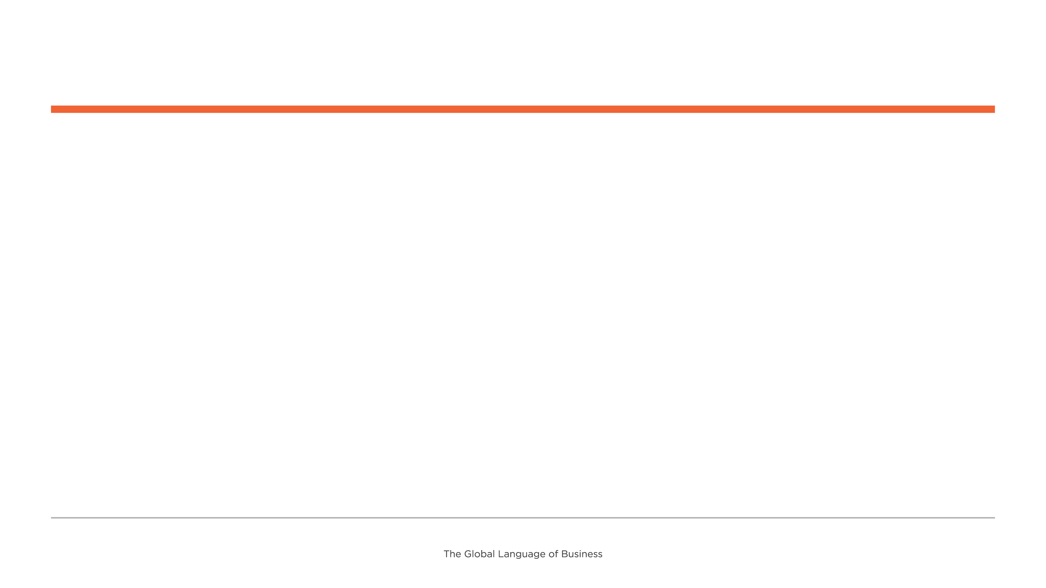
New EU requirements for MUDI Updates MSWG
Report Date: April 2026
Expected close date: June 2026
Project Lead: Greg Rowe
Business purpose
This group will develop the appropriate solution. The European (EU) Commission submitted a work request to develop the creation of “Master UDI-DI" for spectacle frames, spectacle lenses and ready-to-wear reading spectacles as part of the UDI requirements based on the European Medical Device Regulation (MDR).
Key issues and risks
EU COM delegated act has not been finalised. The team is moving forward with the current understanding of the potential language in the delegated act which could impact the draft GSCN.
Accomplishments this period
ID SMG Work Request on which AI (Application Identifiers) accompany AI(03) passed eBallot
BRAD passed eBallot
Upcoming period activities
Begin Solution phase with the Work Request for AI(03) complete

Slide 2
og
New EU requirements for medical devices identification MSWG |  |  |  |  |  |  |  |  |  |  |  |  |  |  | Reporting Period:
Overall Status
# | Standard/guideline Milestones |  |  | Due Date |  | Notes | Notes | # | Collateral milestones |  |  | Due date | status | Notes | Notes | Due date
1 | Master UDI-DI GSCN |  |  | Q2 2026 |  |  |  | 1 | TBD |  |  | TBD |  |  | https://www.gs1.org/industries/retail/2D-barcodes
2
3
4
5
Stakeholders |  |  |  |  |  |  | Project Scope, Resources and Timeline Change Management |  |  |  |  | Other | Key issues & risks
 |  |  |  |  |  |  | Kick-off call May 2025
New risks identified |  | Yes/no | Change request included | No | Yes/no |  | Legend |  |  | Complete | Not Started |  | On target |  | Risk of being late | Change needed (not recoverable)
Sponsor | Robert Beideman
SDL | Greg Rowe
CE/Sol Liaison | Claire Clarke
SME | Neil Piper
AG Liaison | Shekhar Nambi – J&J
Chairs | Lionel Tussau – Bayard Consulting, Sylvia Reiingardt – GS1 Germany, Jeremie Consoln

